Slide 1
Presented By: ARUN PRAGASH M B.TECH INFORMATION TECHNOLOGY III YEAR UCEV VILLUPURAM arunpragash2001@gmail.com

Slide 2
A Generative Model for Data Augmentation using GAN

Slide 3
AGENDA
Problem statement
Project overview
Who are the end users?
What it’s social impact?
Proposed Solution
The wow in my Solution
System Approach
Algorithm and Deployment
Result
Conclusion
References

Slide 4
PROBLEM STATEMENT
This project aims to develop a generative model for data augmentation using generative adversarial networks (GANs) applied to the mnist dataset. The goal is to address the challenge of limited labeled training data by generating synthetic data that closely resembles the original dataset, thereby enhancing the performance of machine learning models trained on mnist.

Slide 5
PROJECT OVERVIEW
Data augmentation is a crucial technique in machine learning, especially when dealing with limited datasets.
By generating synthetic data points that are similar to the existing ones, it helps in improving model generalization and robustness.
Generative models, such as Generative Adversarial Networks (GANs) or Variational Autoencoders (VAEs), offer a powerful framework for creating realistic synthetic data.

Slide 6
WHO ARE THE END USERS?
Data scientists
ML engineers
Researchers
Developers
Industry professionals
Data analysts
Academics
General users

Slide 7
WHAT IT’S SOCIAL IMPACT?
->Improves model accuracy
Fairness and innovation
->Decision-making and analysis
Knowledge sharing
->Accessibility to AI technologies

Slide 8
PROPOSED SOLUTION
GANs are a class of deep learning models which consist of two neural networks a generator and a discriminator.
Generator:
It learns to generate synthetic data samples that resemble real data from a given dataset.
Typically consists of convolutional or fully connected layers followed by activation functions like ReLU or tanh.
Discriminator:
It receives both real data samples from the dataset and fake samples generated by the generator and learns to distinguish between real and fake data samples.
Typically consists of convolutional or fully connected layers followed by activation functions like LeReLU and a sigmoid activation function in the output layer.

Slide 9
THE WOW IN MY SOLUTION
Realistic Data Synthesis
Addressing Data Scarcity
Improved Generalization
Uncovering Hidden patterns
Customization and Control
Novelty and Creativity
Efficiency and Scalability

Slide 10
SYSTEM APPROACH
1. Hardware Requirements:
CPU: While a multicore CPU is adequate for running the training process, training can become computationally intensive. Opting for the fastest CPU available can help minimize training time.
Memory(RAM): A minimum of 8 GB of RAM is advised for effectively managing large datasets and optimizing deep neural network training. Furthermore, a higher RAM capacity could be advantageous for handling larger batch sizes and intricate model architectures.
Internet Connection: To facilitate the download of the MNIST dataset and access online resources or documentation during development, an internet connection is required.

Slide 11
SYSTEM APPROACH – CONT.
2.Software Requirements:
Python: The project is coded using the Python programming language, leveraging its versatility and extensive library ecosystem for efficient development.
TensorFlow/Keras: TensorFlow and its high-level API Keras are instrumental in building and training GAN architectures, simplifying the process and enabling efficient experimentation.
Google Colab: These platforms facilitate interactive development, experimentation, and documentation, promoting dynamic and collaborative workflows.
NumPy: Powerful for numerical computation and array manipulation.
Matplotlib: Matplotlib is used for data visualisation included plotting original, synthetic and augmented data.

Slide 12
ALGORITHM & DEPLOYMENT
Data Preparation:
Loaded the MNIST dataset.
Pre-processed them to normalize the pixel values in the range[-1,1].
Generator Network:
Define the generator network architecture.
Build a convolutional or fully connected layers followed by activation functions like ReLU or tanh.
Compile the generator model.
Discriminator Network:
Define the discriminator network architecture.
Build a of convolutional or fully connected layers followed by activation functions like LeReLU and a sigmoid activation function.
Compile the discriminator model.

Slide 13
ALGORITHM & DEPLOYMENT (CONT..)
Generative model training:
Train the GAN generative model on the MNIST dataset to learn the underlying data distribution.
Synthetic data generation:
Generate synthetic data points using the trained generative model, ensuring that the generated samples are diverse yet realistic.
Evaluation metrics:
Define evaluation metrics to assess the quality and diversity of the generated data compared to the original dataset.
Data augmentation:
Integrate the generated synthetic data with the original dataset to create an augmented dataset for training machine learning models.

Slide 14
ALGORITHM & DEPLOYMENT(CONT..)
Hyperparameter Tuning:
To optimize the GAN performance ,conduct the hyperparameter tuning experiments.
Test the variations in the learning rate, batch size, optimizer.
Select the hyperparameters that boost the performance based on evaluation metrics.
Deployment:
The project, including the trained GAN model and code, is on GitHub for easy access.
The README provides clear instructions for training the model and generating samples.
Documentation explains the GAN algorithm, architecture, and training process.
Deployment instructions cover deploying the model for inference and integration into other applications.

Slide 15
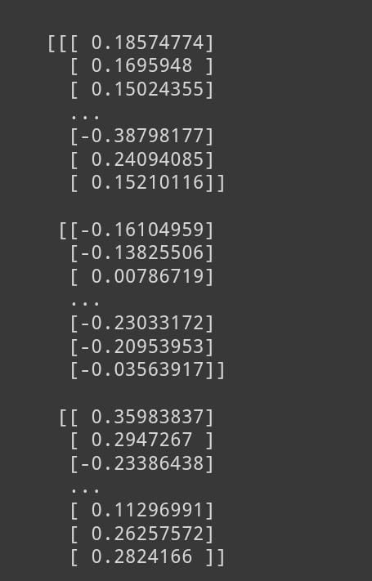
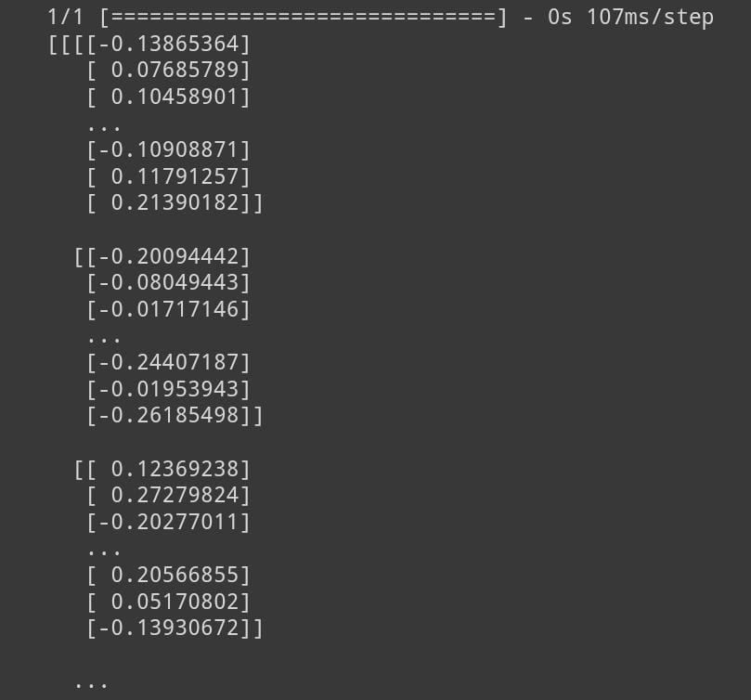
RESULT
OUTPUT OF AUGMENTED DATA
OUTPUT OF SYNTHETIC DATA

Slide 16
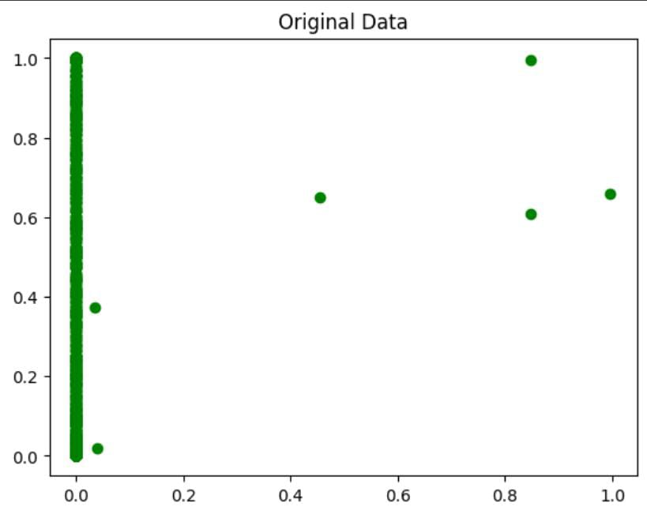
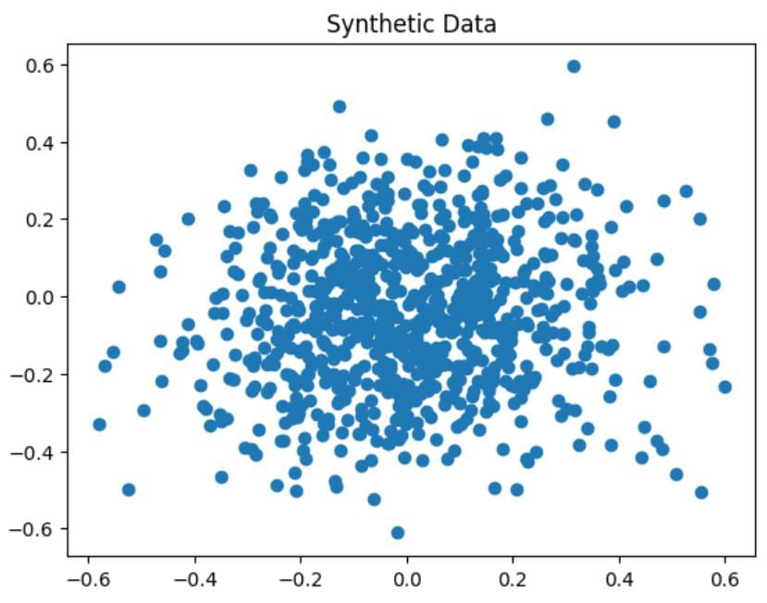
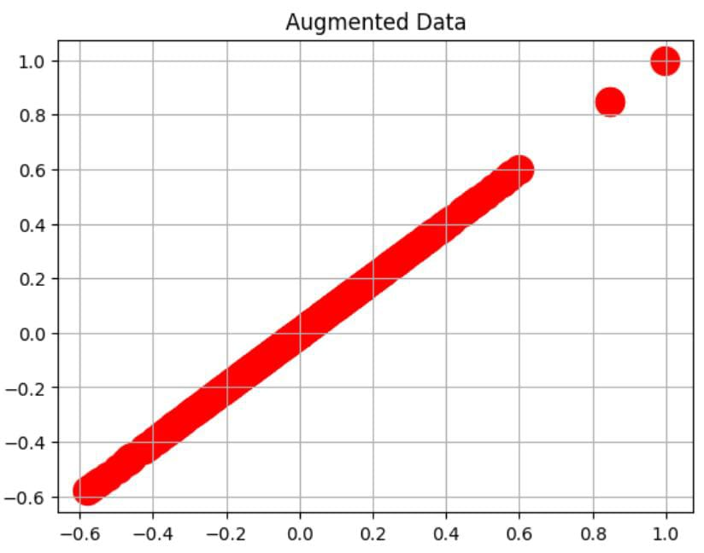
RESULT(CONT…)

Slide 17
CONCLUSION
This project employed a generative model such as GAN (Generative Adversarial Network) for data augmentation presents a promising approach to enriching datasets. By generating synthetic data that closely mimics the characteristics of real data, GAN-based augmentation can enhance model robustness, generalization, and performance.
However, careful consideration of the data distribution, model architecture, and training process is crucial to ensure the effectiveness and validity of the augmented data. Overall, leveraging GANs for data augmentation holds significant potential for advancing machine learning tasks across various domains.

Slide 18
REFERENCES
https://numpy.org/
https://keras.io/
https://matplotlib.org/
https://www.tensorflow.org/
https://scikit-learn.org/stable/
http://yann.lecun.com/exdb/mnist/

